Slide 12
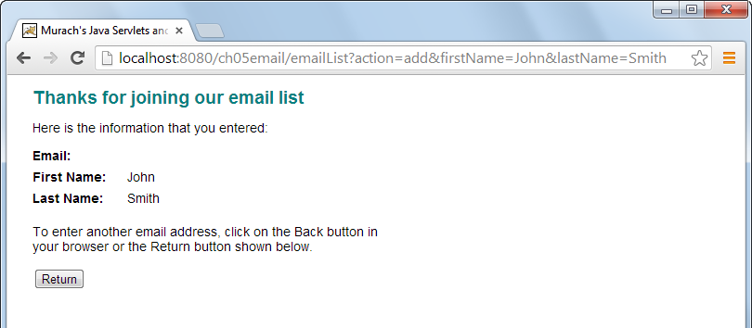

Slide 14
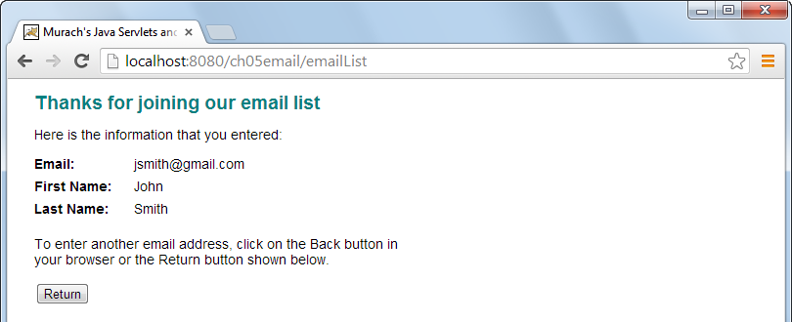

Slide 22
Notes:
The scope of the User object is only available to the JSP, not available later in the session → chapter 7
These methods are most often used in conjunction with a RequestDispatcher object

Slide 25
Notes:
Typically use this technique when you want to transfer control to a URL outside of your application
Servlet engine → convert absolute URL → server send absolute URL to the browser.

Slide 27
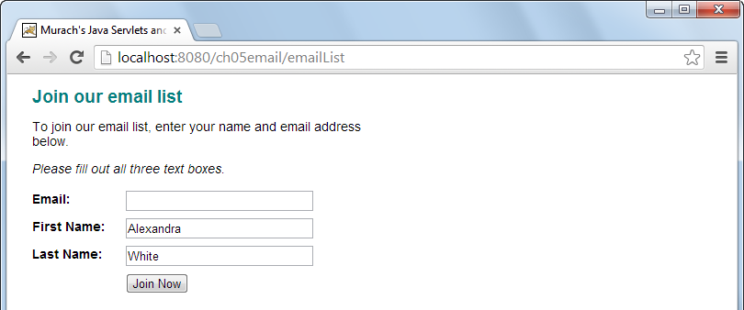
Notes:
How to validate data

Slide 32
Notes:
How to work with xml file

Slide 43
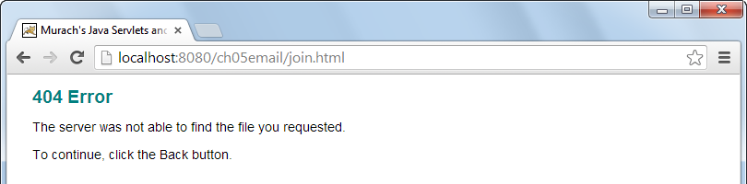

Slide 45
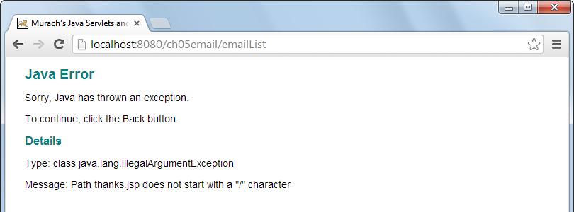

Slide 47
